Slide 1
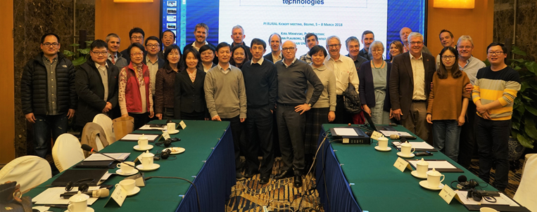
Rural Water and Food Security (PI RURAL) Groundwater Policy Dialogue Themes deriving from Lot 2
Bjørn Kaare Jensen
Geological Survey of Denmark and Greenland
Seminar on Science and Technology Cooperation,
8th High Level Dialogue Meeting, China-Europe Water Platform, Teams, 21 January 2021
Notes:
Cover page

Slide 2
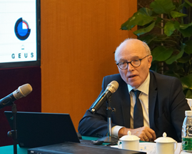
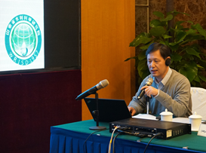
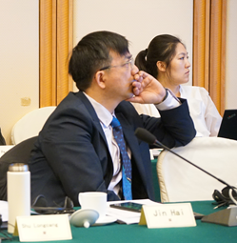
Groundwater Policy Dialogue Themes
2019 Groundwater Quantity Management
GEUS, SYKE, ChinaRM, INTEC, YRCC, Univ of Jinan, Hohai University, CIGEM
Themes:
Aquifer restoration – Managed Aquifer Recharge
Water savings, water reuse and water efficiency measures
Water valorization and water pricing -
Water saving irrigation
Stakeholder participation – awareness raising

Slide 3
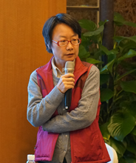
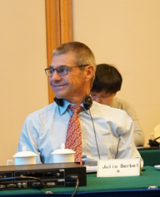
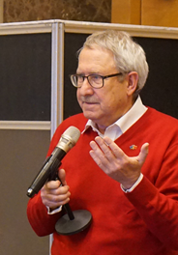
Groundwater Policy Dialogue Themes
2020 Groundwater Quality Management
GEUS, SYKE, ChinaRM, Aarhus university, WRISD (Shandong), CIGEM, WRMC, University of Jinan, BJSMTC, FND-Water, (MEE to be involved)
Themes:
Water quality standards
Groundwater monitoring and data management
Diffuse groundwater pollution (Pesticides, NO3)
Groundwater remediation (PRB, MAR)
Groundwater-based water supply and treatment
Village-level wastewater treatment (Rootzone treatment)

Slide 4
Groundwater Policy Dialogue Themes
2021 Sustainable Use of Groundwater
University of Cordoba, University of Aarhus, COWI, Institute of Geographic Sciences and Natural Resources (IGSNRR), YRCC,
Themes:
Groundwater-based water supply
Water cycle modelling
Water saving irrigation
Conjunctive use of groundwater and surface water
Groundwater – surface water interactions
Water allocation based on societal values of water

Slide 5
Thank you!
感谢您的参与和关注！
www.cewp.eu
Twitter @ChinaEUwater
Notes:
Thank you page – web + place for additional contact info. Change background colour by right-clicking → Edit background Fill → colour

